Slide 1
Predictive Biomarker Modeling of Early Progression in Nivolumab-Treated Melanoma Patients
IPS | Translational Bioinformatics / GBDS | Data Science
March 17, 2021
Abraham Apfel (IPS/BIOM) and David Paulucci (GBDS/Data Science)

Slide 2
Goals of the analysis
Primary goal: Develop a prognostic score to predict primary resistance (binary outcome) from Melanoma subjects receiving IO treatment
Secondary goal: Which biomarkers are influential in determining the predicted probability of a patient being primary resistant?
Secondary goal: Identify any potential predictive effects, i.e. are there predictors which can help decide on appropriate IO treatment for a given patient?
Assessed predictor * treatment interaction to determine if the relationship between a given biomarker and the predicted probability for being primary resistant differ across different treatment arms

Slide 3
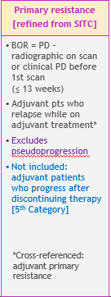
Consort Diagram
I-O treated subjects from CA209 studies: -003, -004, -037, -038, -064, -066, -067, -069, -511, -742, and -238
N=3462
Metastatic studies only (excluded -238)
n=2504
Patients who were “evaluable” for primary resistance
(excluded patients who were not evaluable for primary resistance)
n=2272
Cutaneous melanoma subjects
n=1638
Non-Cutaneous melanoma subjects
n=500
* n=134 with subtype missing excluded
YES primary resistant
n=585
NOT primary resistant
n=1053
YES primary resistant
n=236
NOT primary resistant
n=264
IPI | NIVO | NIVO+IPI
383/2272 | 1020/2272 | 869/2272
Model Development
Internal Validation
Internal Validation

Slide 4
Initial candidate pre-treatment covariates used to model primary resistance
Treatment arm as randomized
Patient Characteristics:
Age at consent
Sex
Race
ECOG PS
Continent
BMI
Disease Characteristics:
M stage
AJCC stage
Melanoma subtype
Baseline tumor burden
Liver metastases
Biomarkers/Labs:
PD-L1 expression (%)
BRAF mutation status
Hemoglobin level
LDH
Absolute lymphocyte count
Absolute neutrophil count
Platelet count
Medical History:
Time from current diagnosis to treatment start date
Antibiotic use within 30 days of treatment
Antacid (PPI or H2 blocker) use within 30 days of treatment
Prior BRAF inhibitor treatment
Prior ipilimumab treatment
TM/IPS Analysis Only
TMB
CD8 IHC
Gene expression (RNAseq)

Slide 5
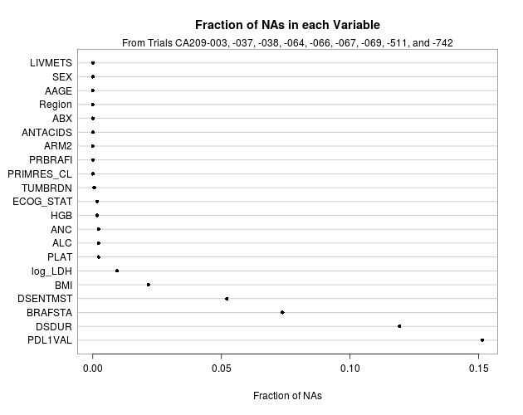
Statistical Methodology Challenges
Missing data
Imputations with “block missing” (certain covariates were missing from complete trials)
Combining imputation with validation
“Trial” effect
Comparing multiple modeling approaches
N = 1638
9 Clinical Trials
4 Treatment Arms

Slide 6
Analysis Outline
Two Imputation Approaches Evaluated
Multiply imputed 32 datasets followed by resampling.
Single imputation within resampling.
Performed many modeling techniques
Frequentist and Bayesian logistic regression, penalized logistic regression, machine learning (Gradient Boosting Machines, Random Forests)
Perform internal validation on each approach
Optimism-corrected bootstrap
Nested, Repeated CV
Internal-External CV
Compare predictions and performance metrics of each approach
Prediction Matrix
R2, AUC
Produce appropriate visualizations

Slide 7
eXtreme Gradient Boosting (XGBoost)
An ensemble based statistical learning method in which small classification trees are sequentially fit to the data.
Each iteration of tree growth uses information of the previously fit trees, by fit to the residuals of ensemble of previously fit trees.
Multiple hyper-parameters tuned via a comprehensive grid search, within the resampling.
Number of trees
Tree depth
Number of variables to grow tree at each iteration
Number of patients to use to grow tree at each iteration
Eta: Shrinkage parameter which shrinks the feature weights to make the boosting process more conservative.
Gamma: Minimum loss reduction required to make a further partition on a leaf node of the tree.

Slide 8
Logistic Regression
Redundancy analysis
See if any candidate predictor can be well predicted from other candidate predictors
Estimate degrees of freedom you can afford to spend in model
Approximate rule of thumb¹: One degree of freedom for every 10-15 “effective” samples in your model
Effective samples = min(∑Y = 0, ∑Y = 1)
Multiple Imputation yields smaller effective sample size than if data were truly complete (but still larger than complete case analysis!)
Shrinkage helps
More rigorous estimation: van Houwelington and le Cessie^{1, 2} shrinkage estimate
¹ J.C. van Houwelington and S. le Cessie. Predictive value of statistical models. Stat Med, 9:1303-1325, 1990.
² Regression Modeling Strategies, Frank Harrell.

Slide 9
Logistic Regression (cont.)
3. Figure out how best to spend degrees of freedom
Run saturated model (allowing non-linear relationship for all continuous markers) to determine which terms to allow non-linearity in reduced model
Apply cubic splines to terms with stronger associations
DON’T test for non-linearity
DON’T plot relationships
4. Explore interactions
Allow for interactions between candidate variables and treatment
Perform “chunk test” (LRT) on all candidate variables simultaneously to see if interactions are worthwhile
5. Run “reduced” model
6. Visualize the results

Slide 10
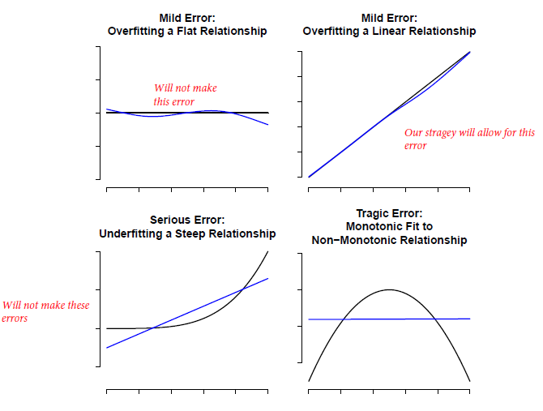
Restricted Cubic Splines
Courtesy of Frank Harrell
https://hbiostat.org/doc/rms1.pdf

Slide 11
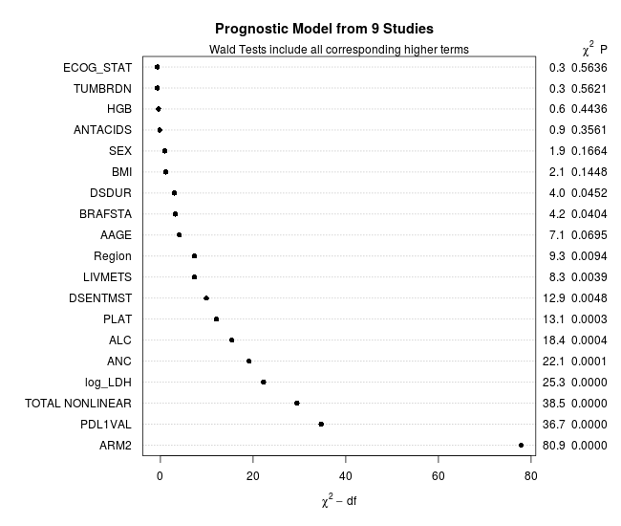
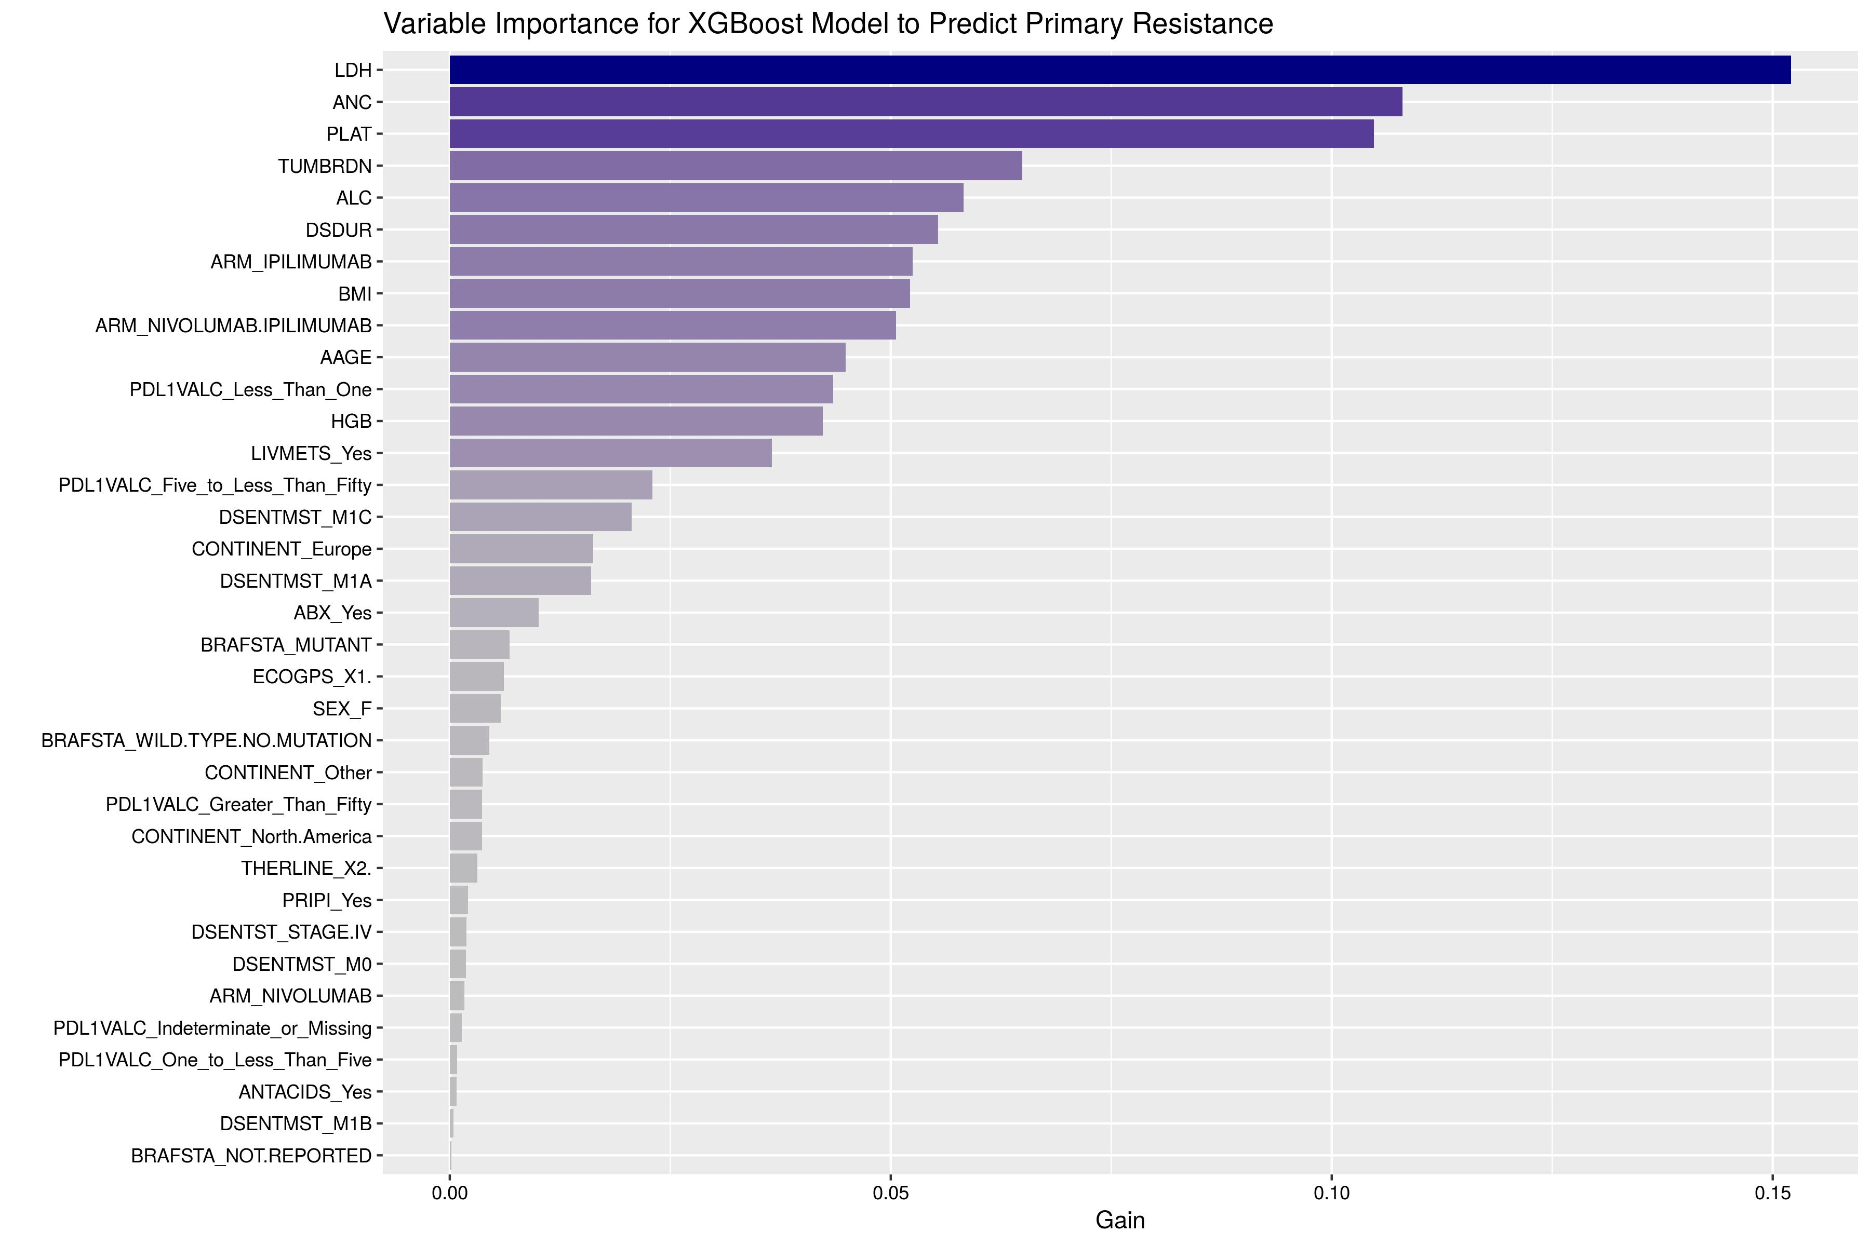
Prognostic Model Summary for Logistic and Bayesian Models
Model: LDH + PDL1 + ALC + Arm + BRAF + ANC + PLAT + Region + DSDUR + BMI + Antacids + HGB + TUMBRDN + LIVMETS + ECOG + Sex + Age + DSENTMST + (Random effect for STUDYID – Bayesian model only)
Due to sample size constraints non-linear effects were only included for PDL1, LDH, ANC, ALC, and Age

Slide 12
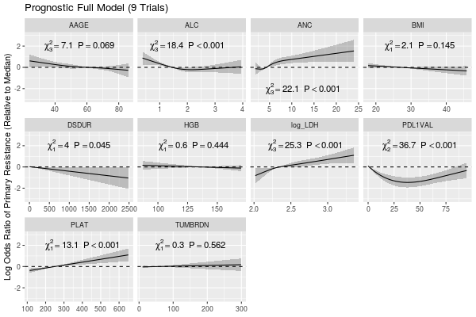
Partial Effects Plots -Relative to Median of Respective Predictor
Model: LDH + PDL1 + ALC + Arm + BRAF + ANC + PLAT + Region + DSDUR + BMI + Antacids + HGB + TUMBRDN + LIVMETS + ECOG + Sex + Age + DSENTMST + (Random effect for STUDYID – Bayesian model only)
Disclaimer: No Causal Inference applied prior to model fitting
Forest plots can be misleading when non-linear terms are present

Slide 13
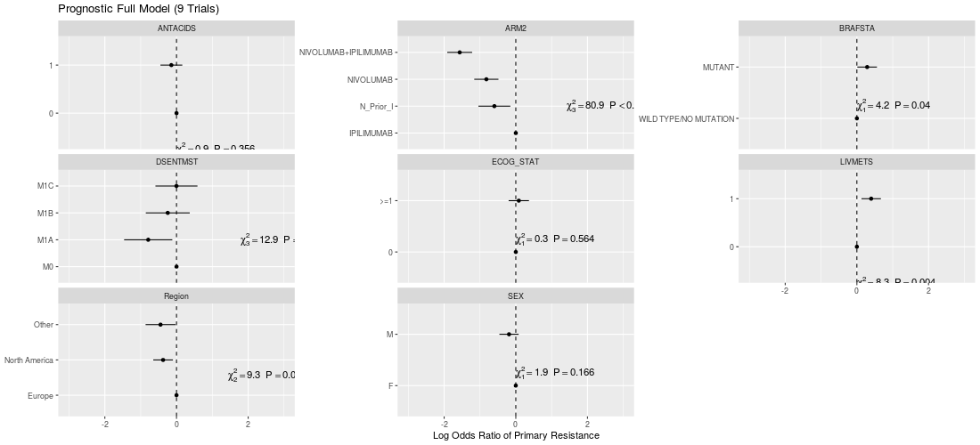
Partial Effects Plots
Model: LDH + PDL1 + ALC + Arm + BRAF + ANC + PLAT + Region + DSDUR + BMI + Antacids + HGB + TUMBRDN + LIVMETS + ECOG + Sex + Age + DSENTMST + (Random effect for STUDYID – Bayesian model only)

Slide 14
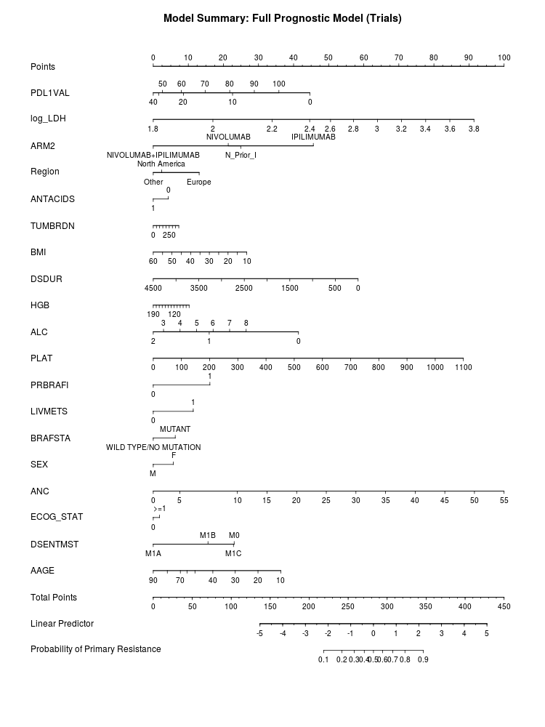
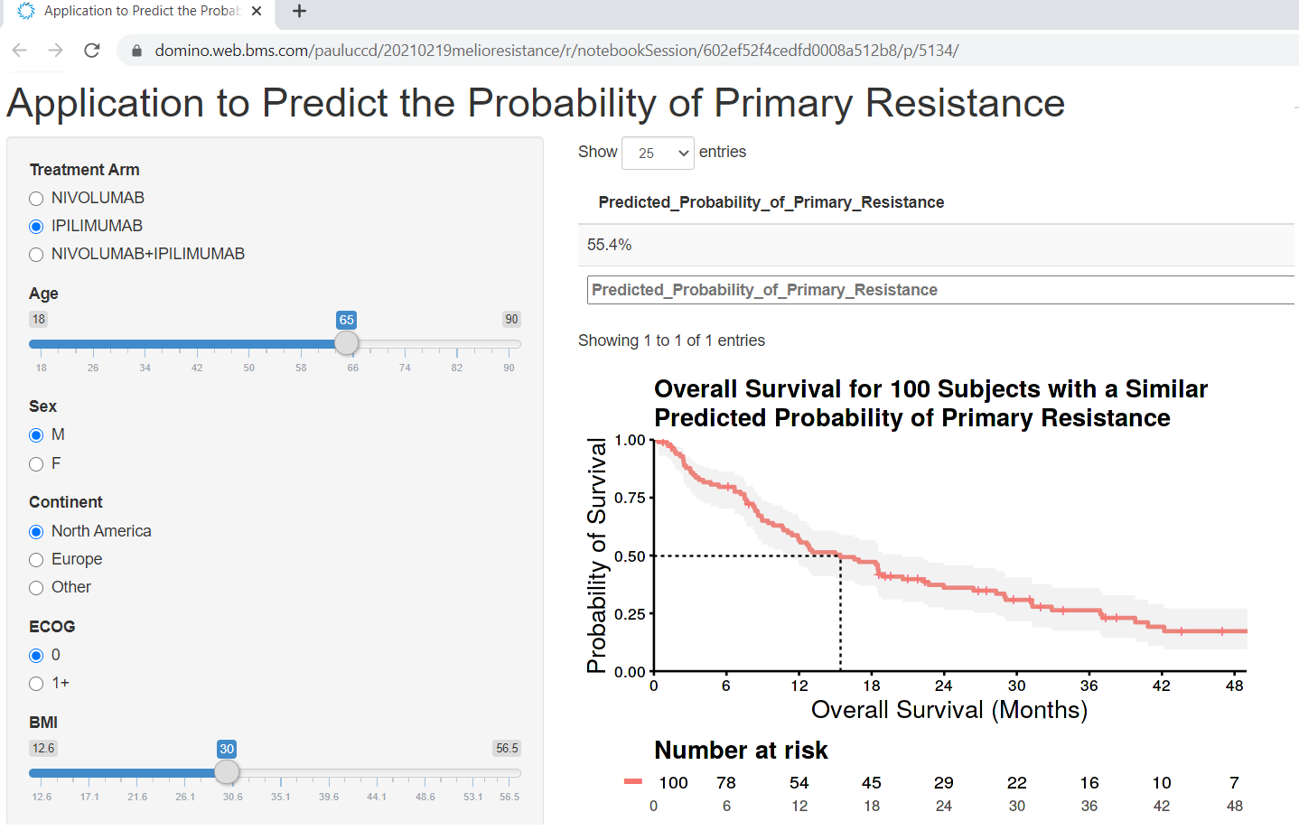
Model Summary

Slide 15
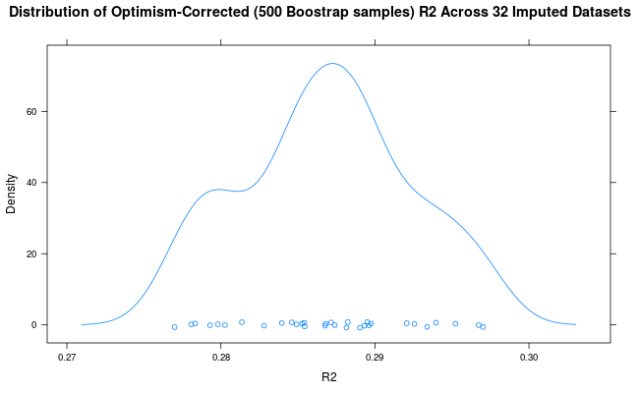
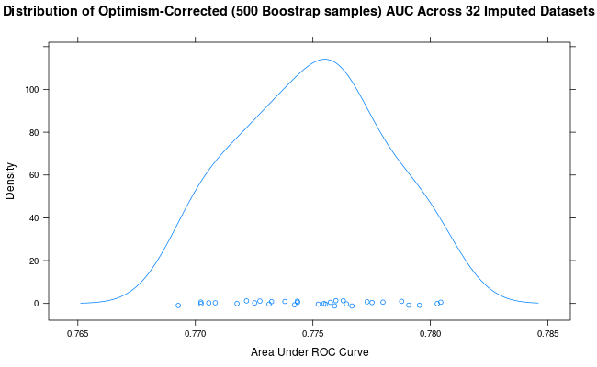
Internal Validation (Discrimination) via Multiple Imputation
Relatively small amount of optimism in discrimination statistics implies minimal overfitting
Can be confident in strength of effects from model
 | Optimism | Corrected
R2 | 0.03 | 0.29
AUC | 0.04 | 0.79
Validation statistics are based off of 500 bootstrap samples from each of 32 imputed datasets¹
¹ Clinical Prediction Models, Ewout Steyerberg.

Slide 16
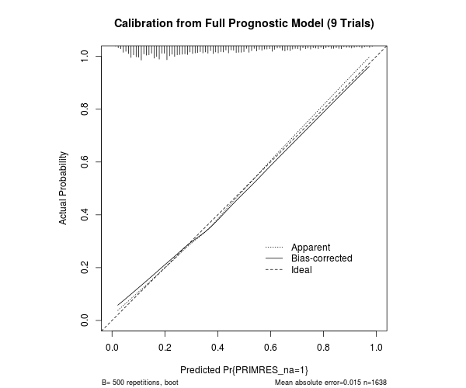
Internal Validation (Calibration) via Multiple Imputation
 | Optimism | Corrected
Calibration Intercept | 0.05 | -0.05
Calibration Slope | 0.1 | 0.9
Calibration assesses how precise predictions are
As opposed to discrimination, which assesses ability to rank subjects correctly
Perfect calibration would have intercept = 0 and slope = 1
500 Bootstrap samples for each imputed dataset
Model seems to be well calibrated – minimal overfitting
Implies confidence that predictions from our modeling can be reproduced in new data
Good discriminatory ability – wide range of predictions
Sample calibration plot from randomly chosen imputed dataset

Slide 17
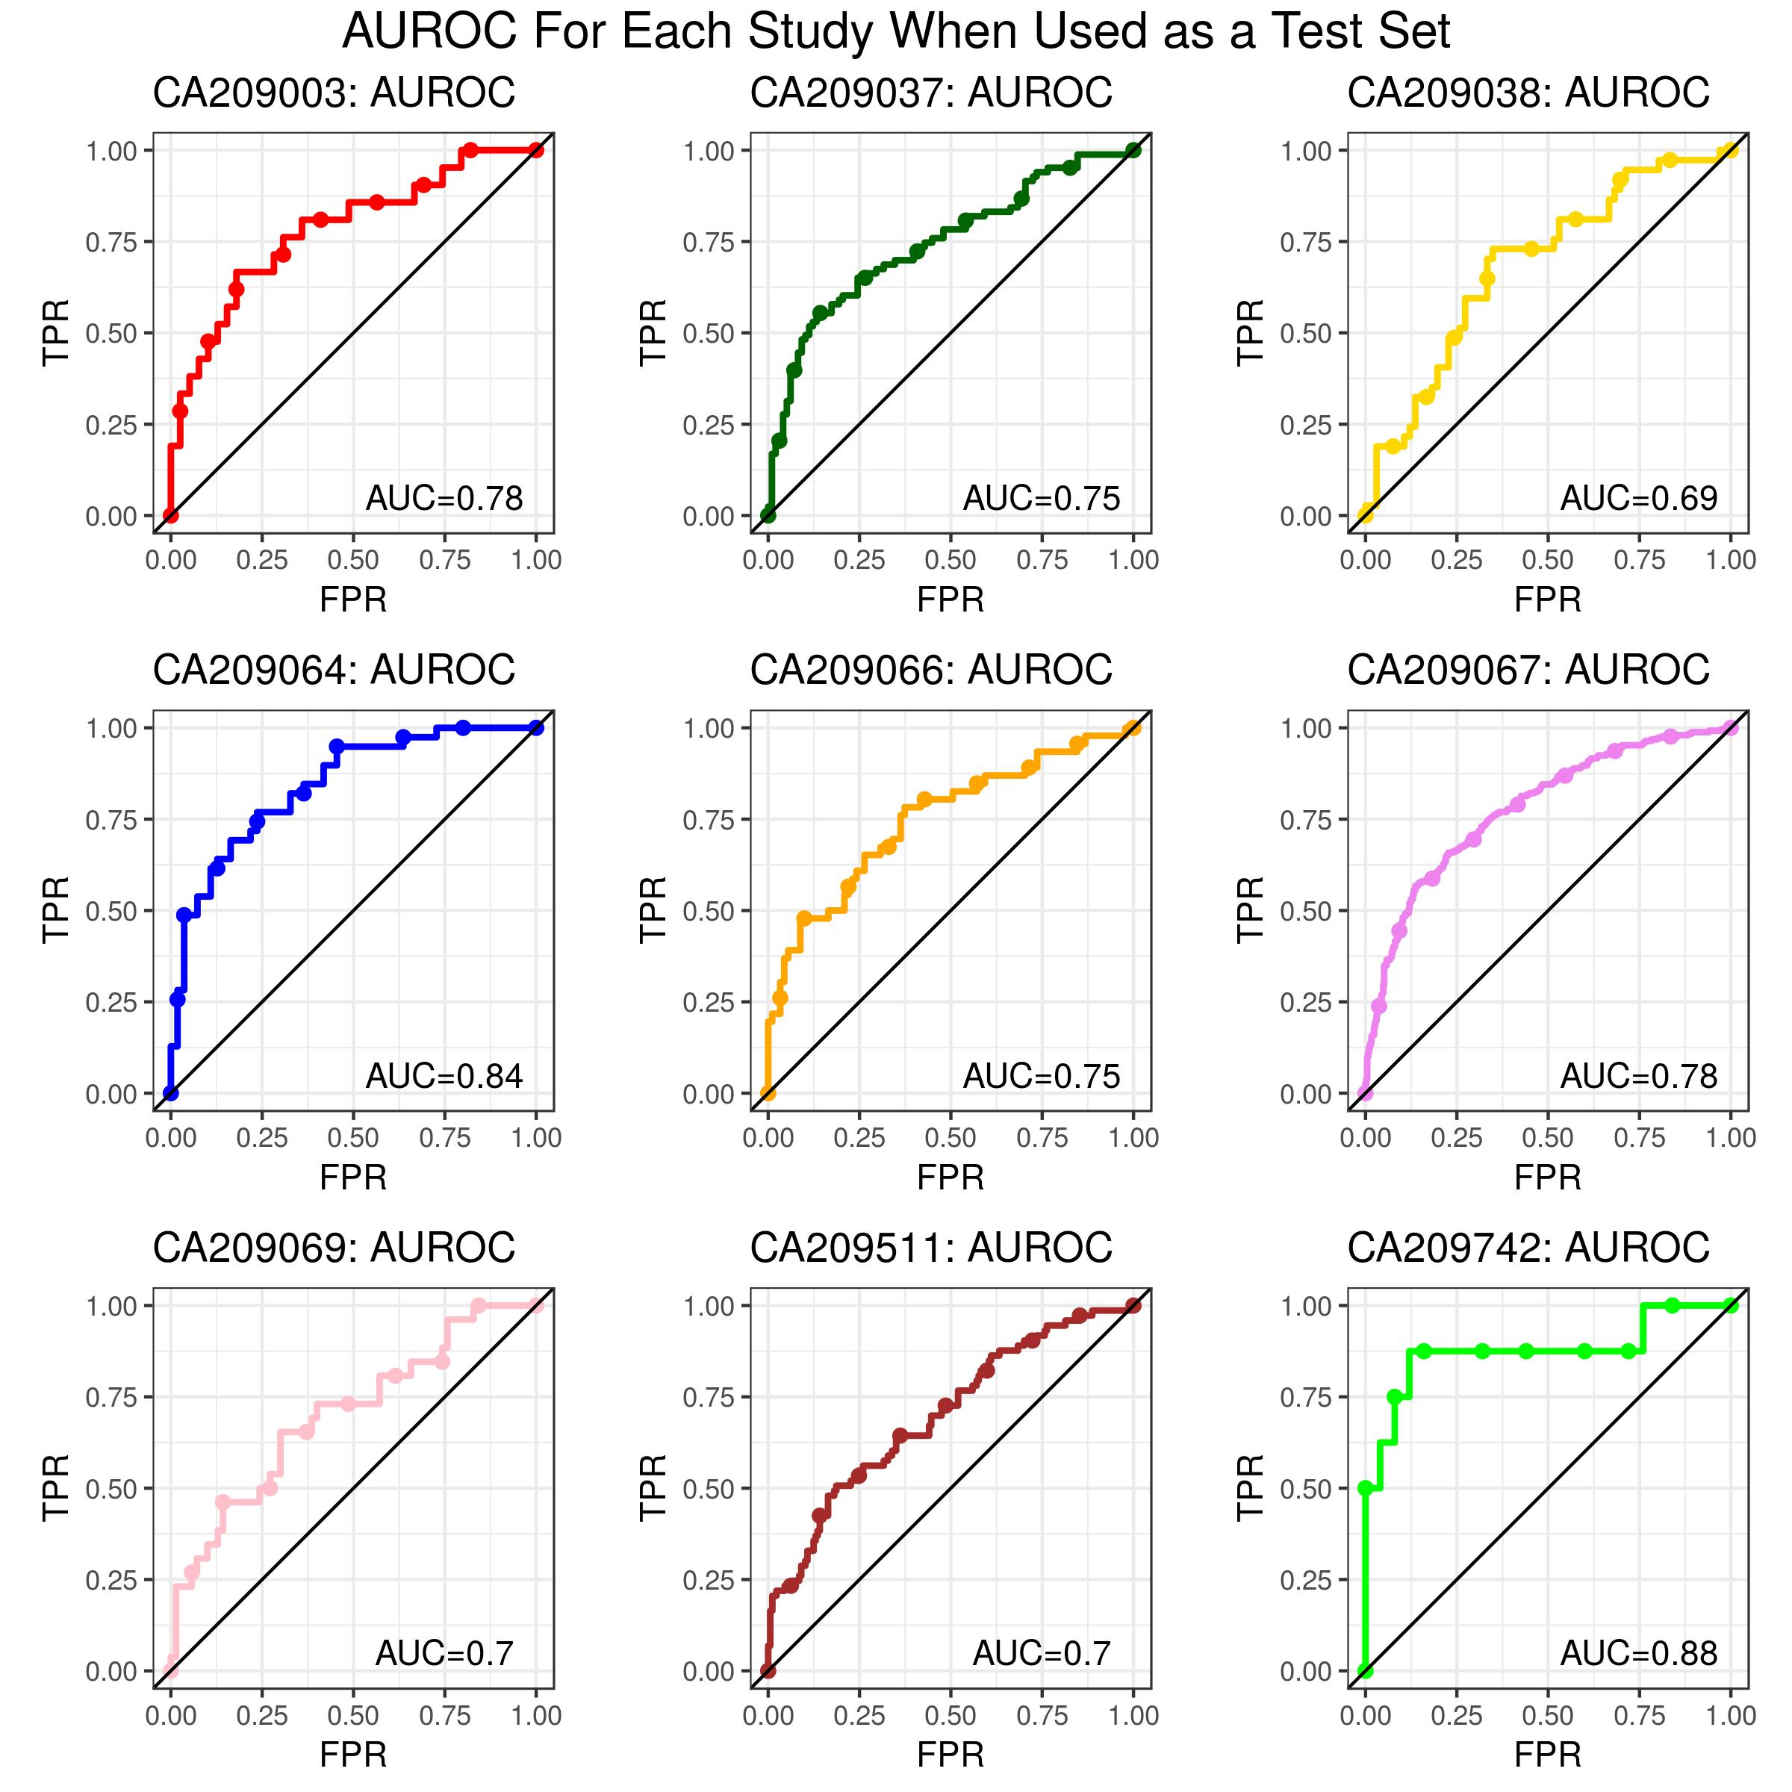
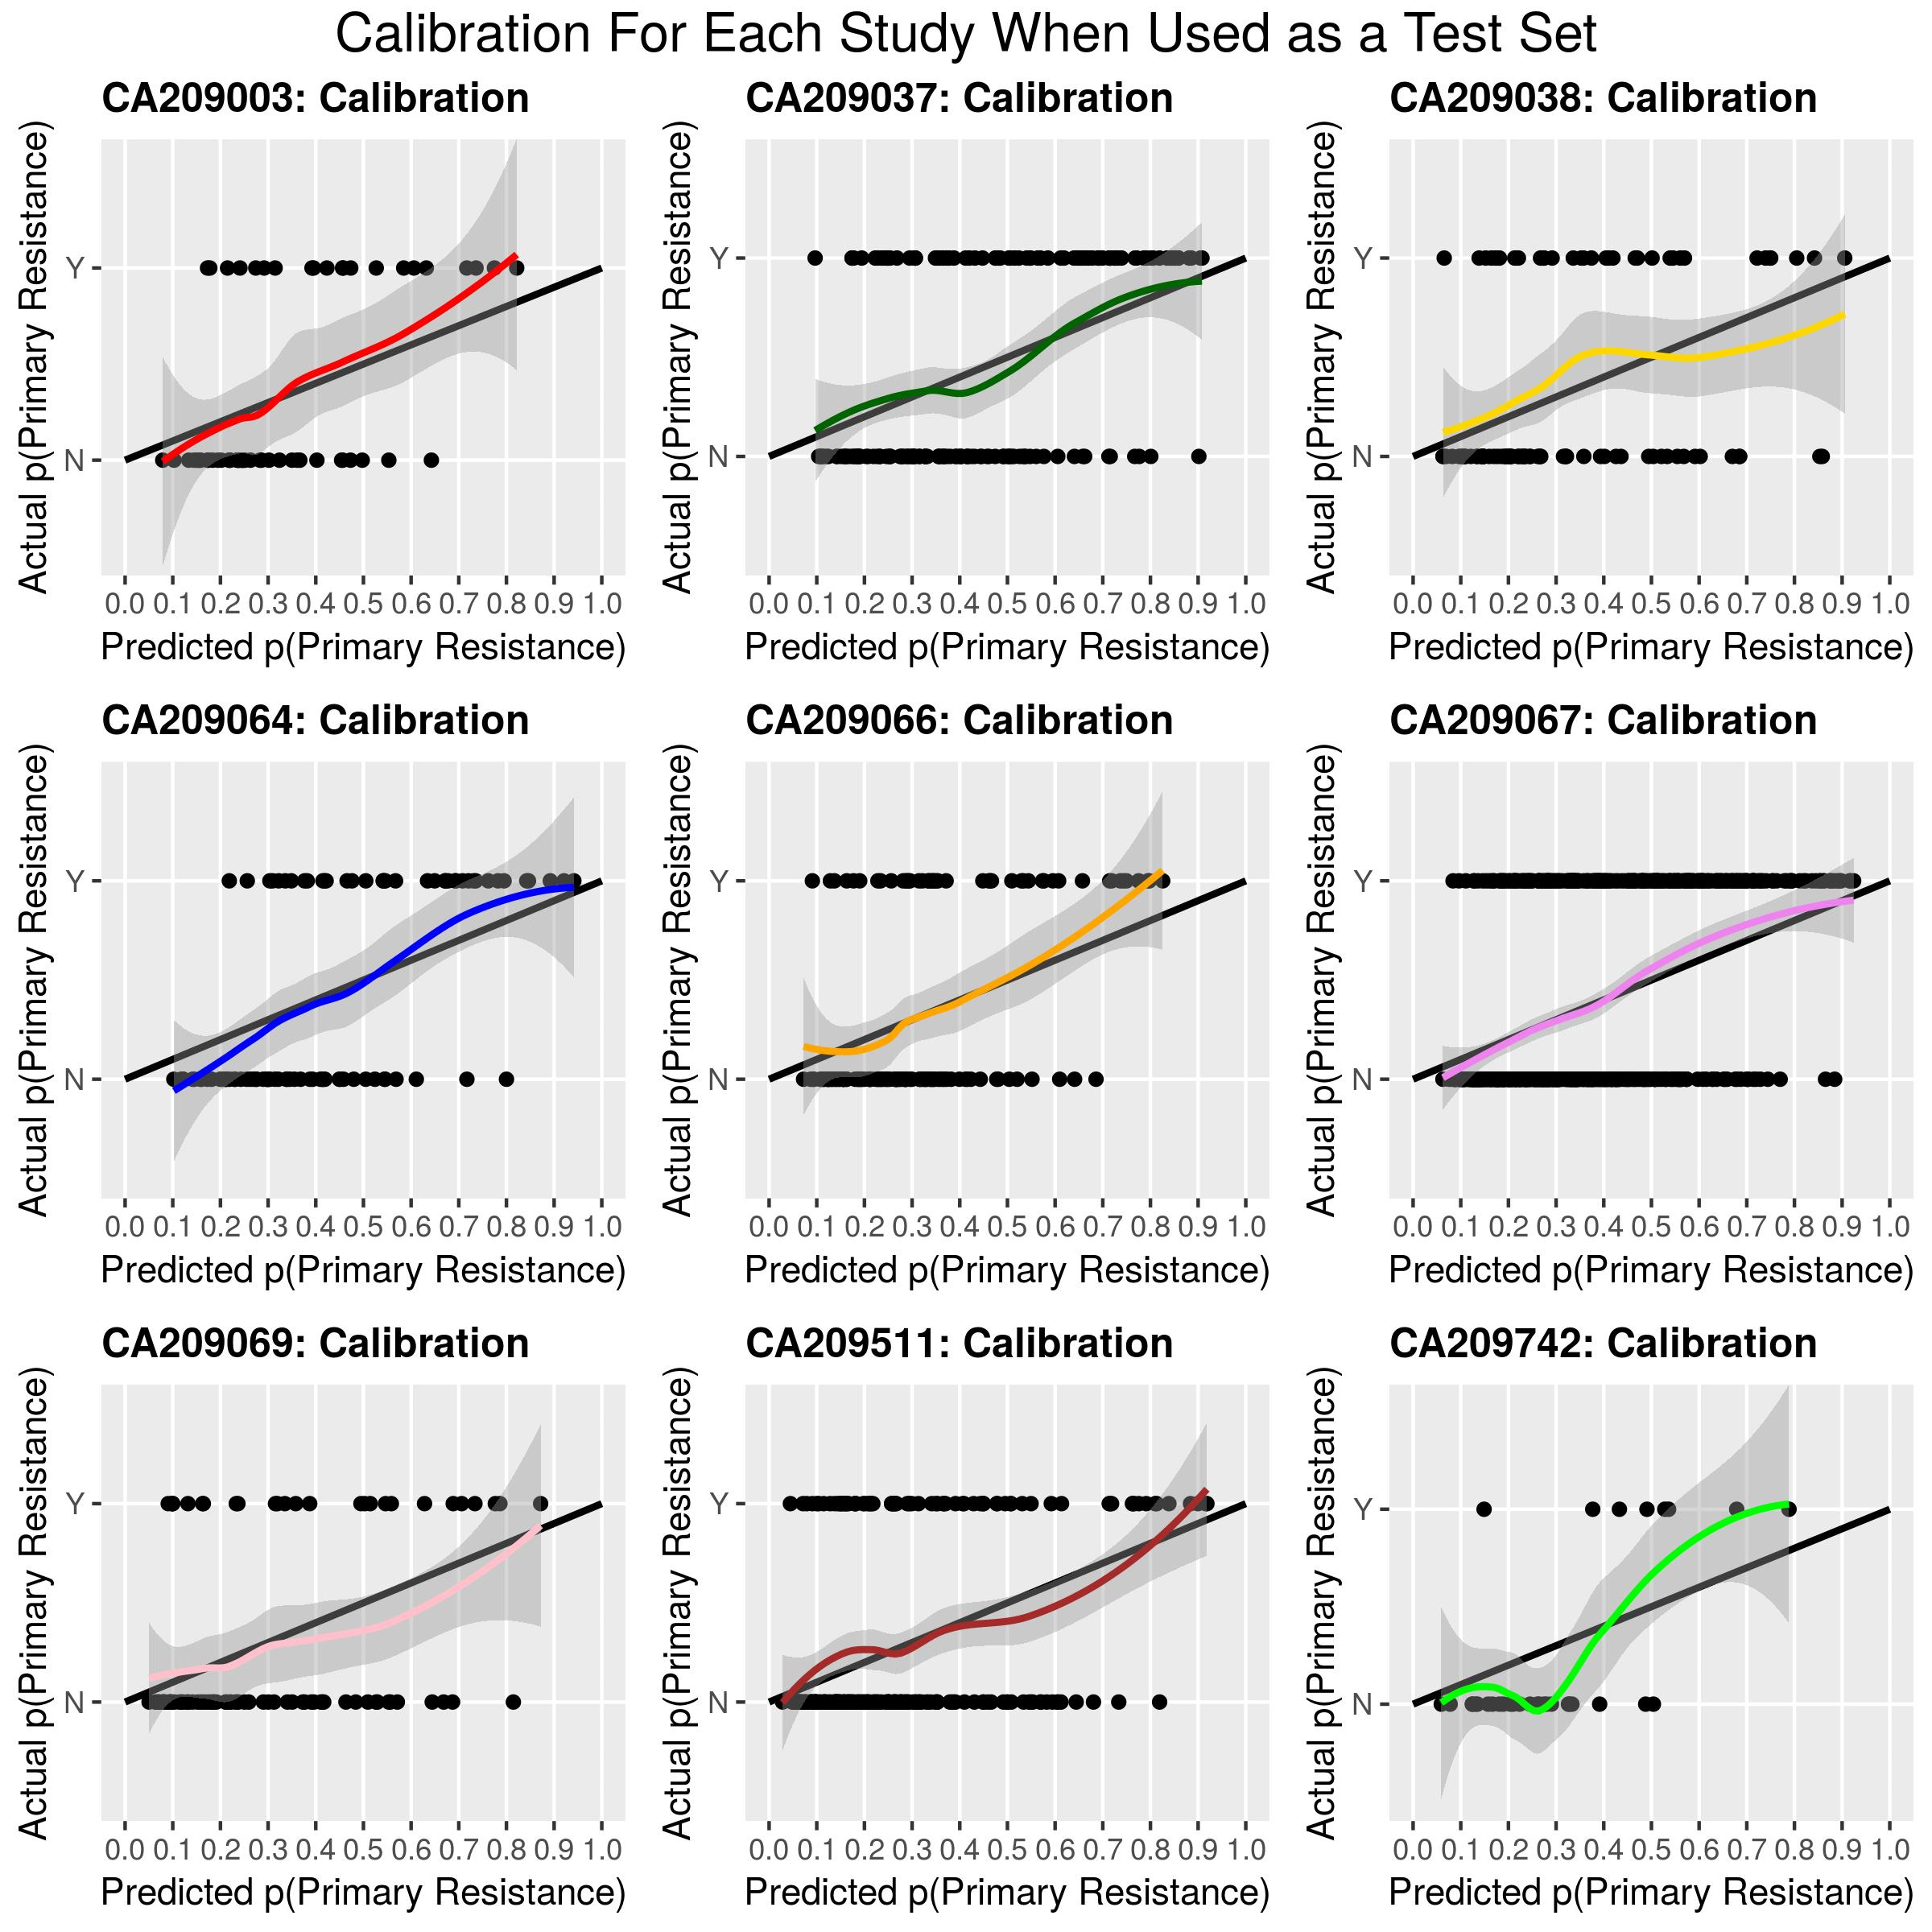
Internal-External Validation Holding Each Study Out Once as a Test Set
Consistently Good performance Across Studies via internal-external Cross-Validation in which each study was held out once as a test set: AUC’s: CM067=0.78, CM038=0.69 , CM742=0.88

Slide 18
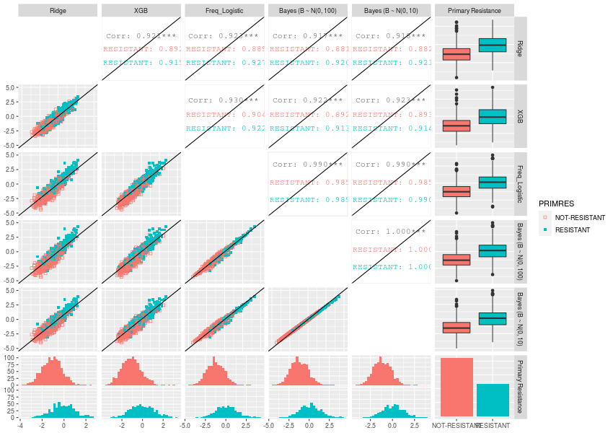
Model Comparison: Prediction Matrix (9 Trials, N = 1638)
If Resistant is above diagonal, “row model” has better predictions
If Non-Resistant is below diagonal, “row model” has better predictions

Slide 19
Current Methodology Challenges
External validation of a Model Developed with Multiple Imputation
With multiple imputation, there are 32 models developed (1 per imputed dataset). How do we combine information across multiple imputed datasets? Should we average coefficients across all imputations? Should we compute separate test statistic for each imputed dataset?
How do we combine imputations with external validation? Do we use current imputation model to impute external missing data? Do we create new imputation model with all data?
Internal validation with Multiple Imputation
Potential for overly optimistic performance estimates since test data is being used to impute training data.
Computationally not feasible to do multiple imputation within resampling.
Is there a more efficient way to model Primary Resistance other than binary endpoint?
Balancing trade-off of patients and potentially important variables into models.
e.g., if we include CRP which is strongly patients, we will lose patients as this is not collected in several trials.
Having multiple models from multiple modelers creates practical challenges for application in future clinical trials.
We recommend apriori agreeing on the same internal validation and performance metrics
Many benefits as well!

Slide 20
Acknowledgements
Scott Chasalow (IPS/BIOM)
Shu-Pang Huang (GBDS)

Slide 21
Backup

Slide 22
Multiple Imputation
Approximate rule of thumb¹: Number of imputations (M) should equal the proportion of rows in your data which are missing in at least one covariate
Had trouble including trial in imputation model due to block missing, left it out
Included outcome in imputation model¹
^{1.} Regression Modeling Strategies, Frank Harrell

Slide 23
Single Imputation
Missingness for each covariate handled with Bagged CART models (1 per covariate with missing data) using available data on other covariates.
These models were developed on the held-in training sets of the cross-validation after resampling to impute the missing training covariates, then applied to the held out sets of the cross-validation to impute missing test set covariates.
Eliminates potential for data leaking between held-in and held-out sets.

Slide 24
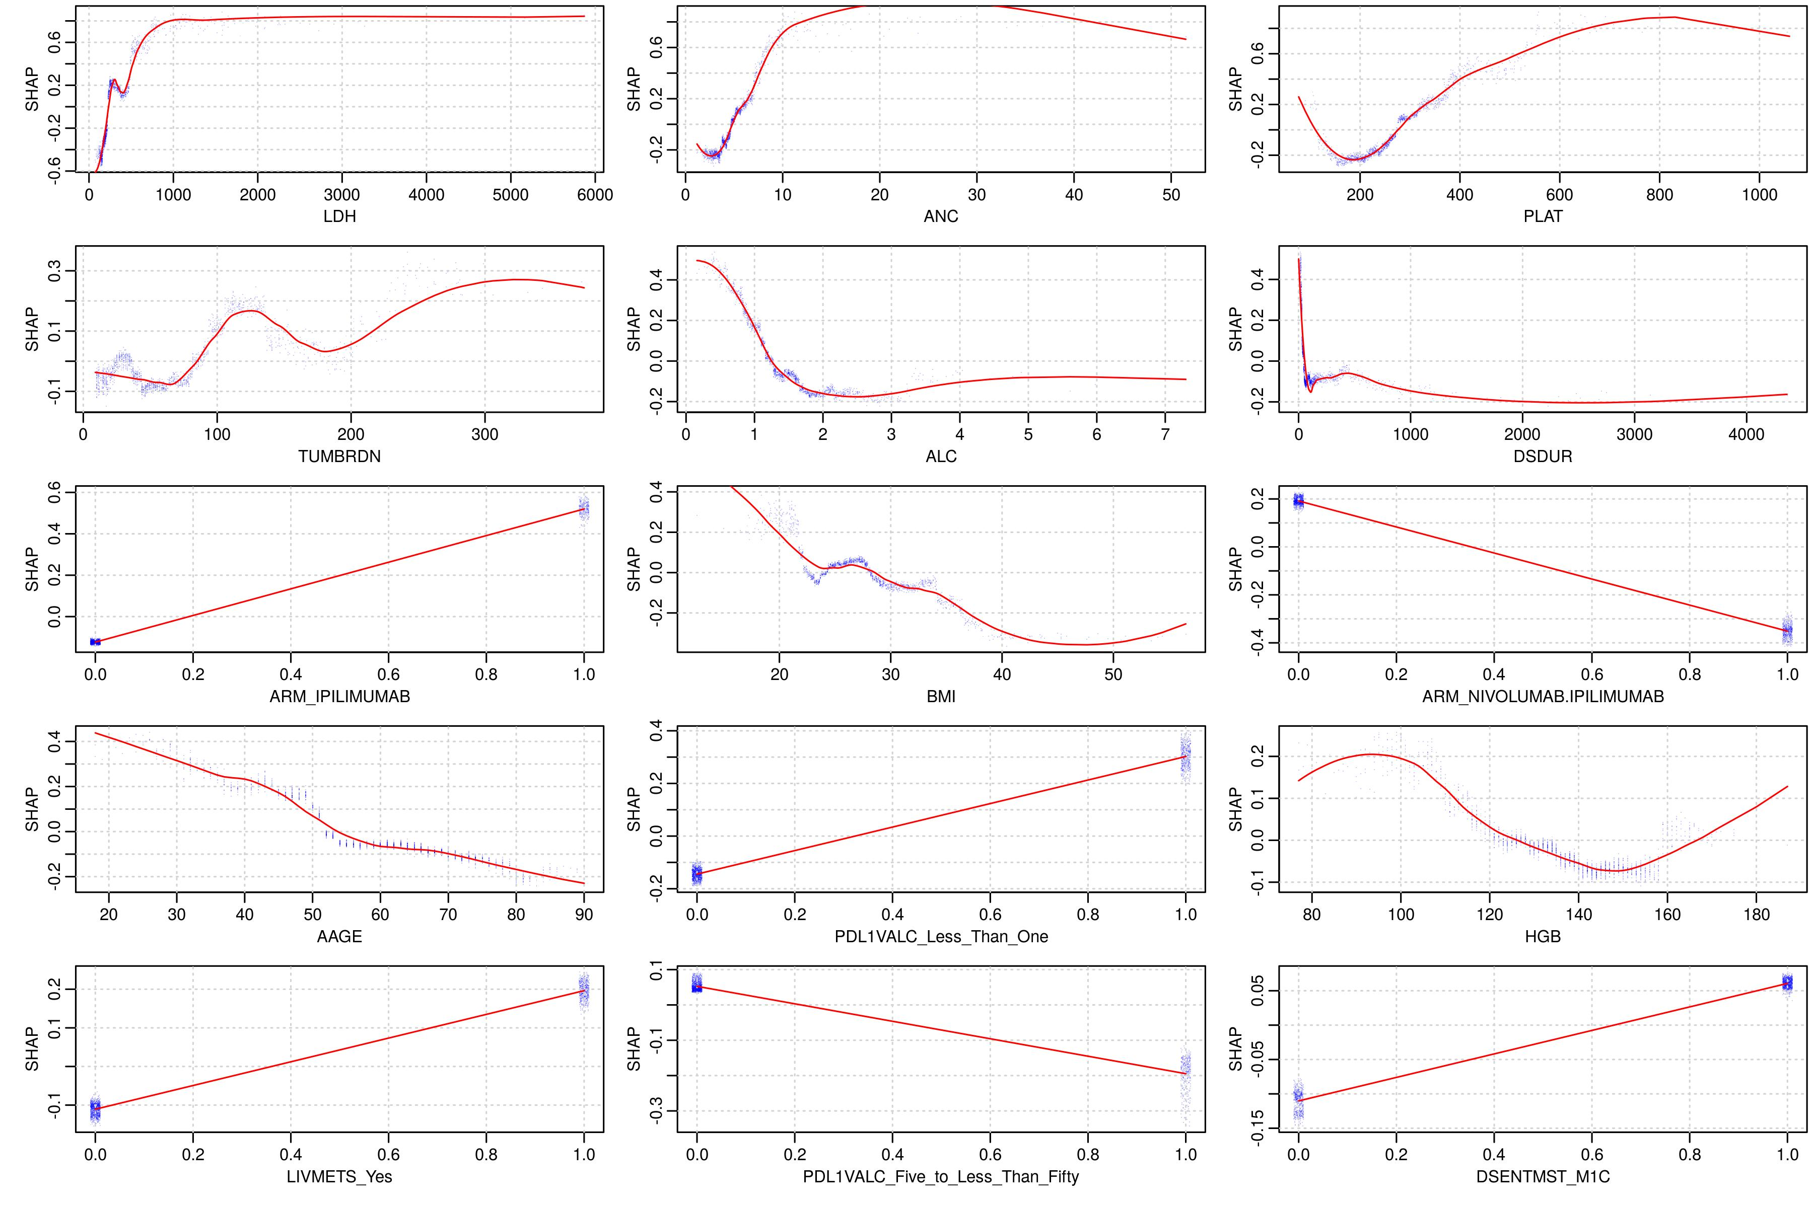
Prognostic Model Summary for XGBoost Model
Top 10 Drivers of Primary Resistance: LDH (+), Platelets (-/+), Neutrophils (+), Lymphocytes (-), Tumor Burden (+), Time to Treatment (-), Treatment Arm (+/-), BMI (-), Age (-), PD-L1 <1% (+)
Covariates and Respective Shapley Values

Slide 25
Optimism-Corrected Bootstrap^{1, 2}
2 reasons to prefer over repeated CV:
Easier to validate with imputed data
Uses full data
Procedure:
Run full model on all of data
Determine performance metrics on full model
Draw bootstrap sample (with replacement) Build model on bootstrap sample and calculate “apparent” performance on same bootstrap sample
Apply model from bootstrap sample on original (full) data
Calculate Optimism by subtracting difference between performance metric calculated in step 3 from that calculated in step 4
After repeating steps 3 – 5 many times, calculate average amount of optimism
Subtract average optimism from performance metric calculated in step 2
Although intuitively there is some leakage in step 4 since on average 63.2% of data from full model is in each bootstrap sample as well, nonetheless both Harrell and Steyerberg assert this method of internal validation has strong basis both in theory and based on many simulations
¹ Clinical Prediction Models, Ewout Steyerberg.
² Regression Modeling Strategies, Frank Harrell.

Slide 26
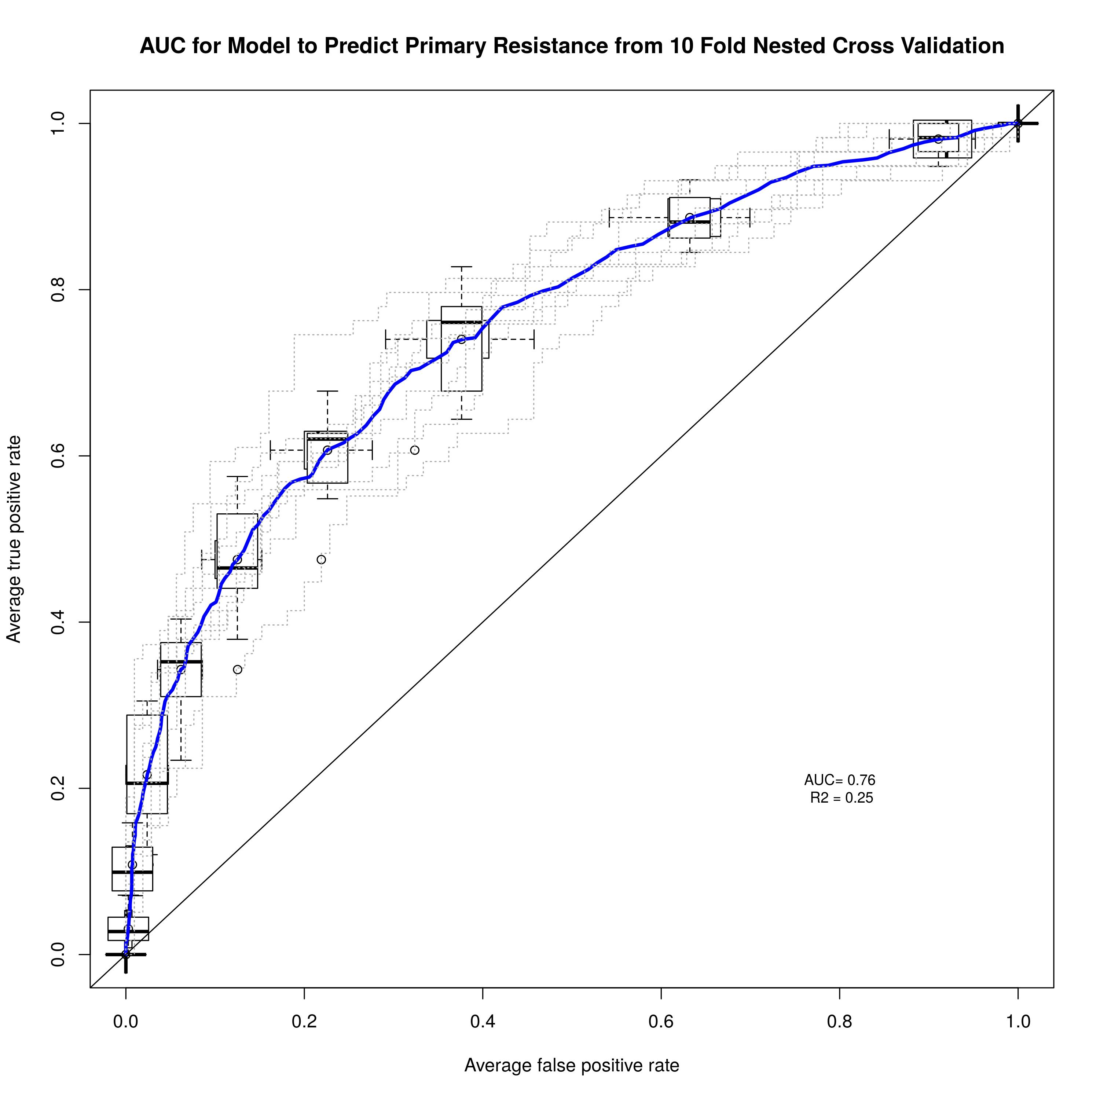
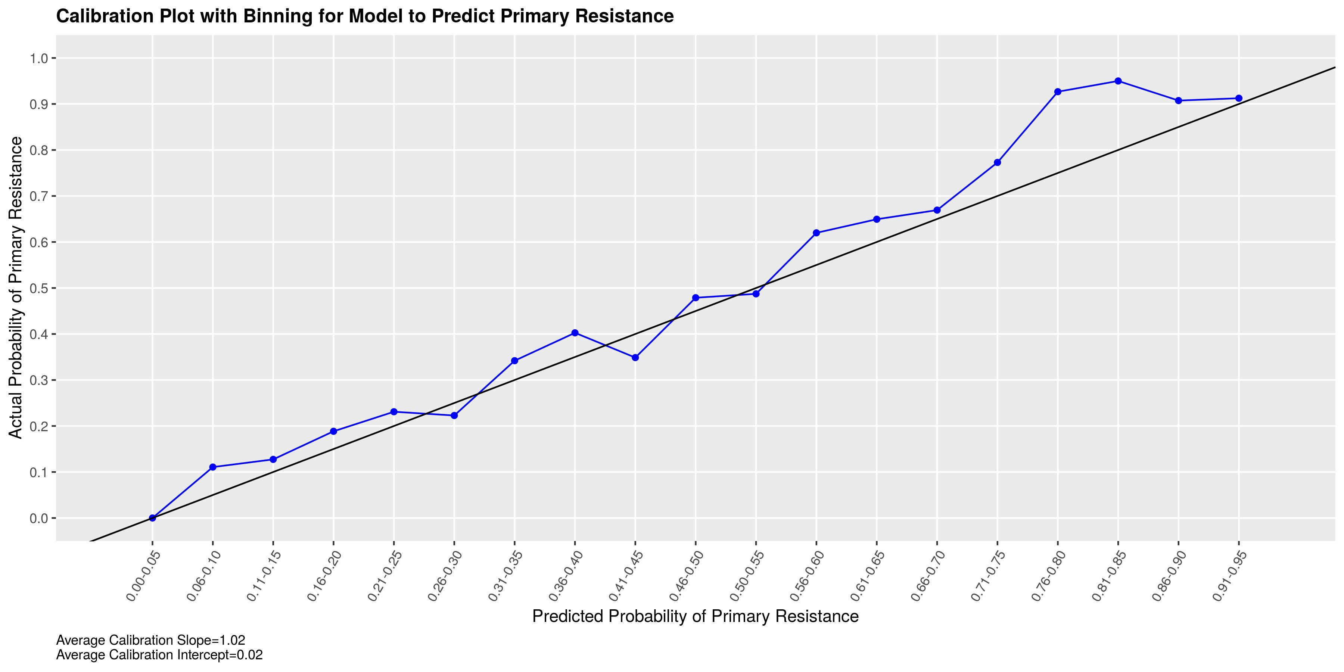
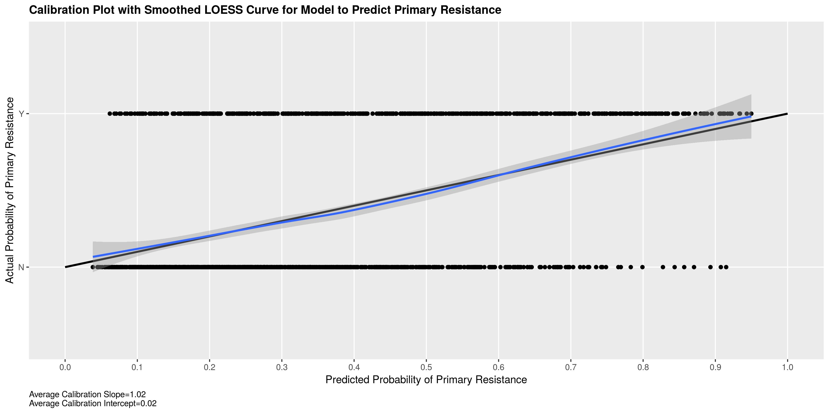
Internal Validation (Discrimination) via Single Imputation
Good Discrimination (AUC=0.76) and Excellent Calibration (β0=0.02; β1=1.02) via internal validation (10 Fold Nested Cross-Validation) on the cutaneous melanoma subjects used in model development.
B0=0.02, B1 = 1.02
AUC = 0.76

Slide 27
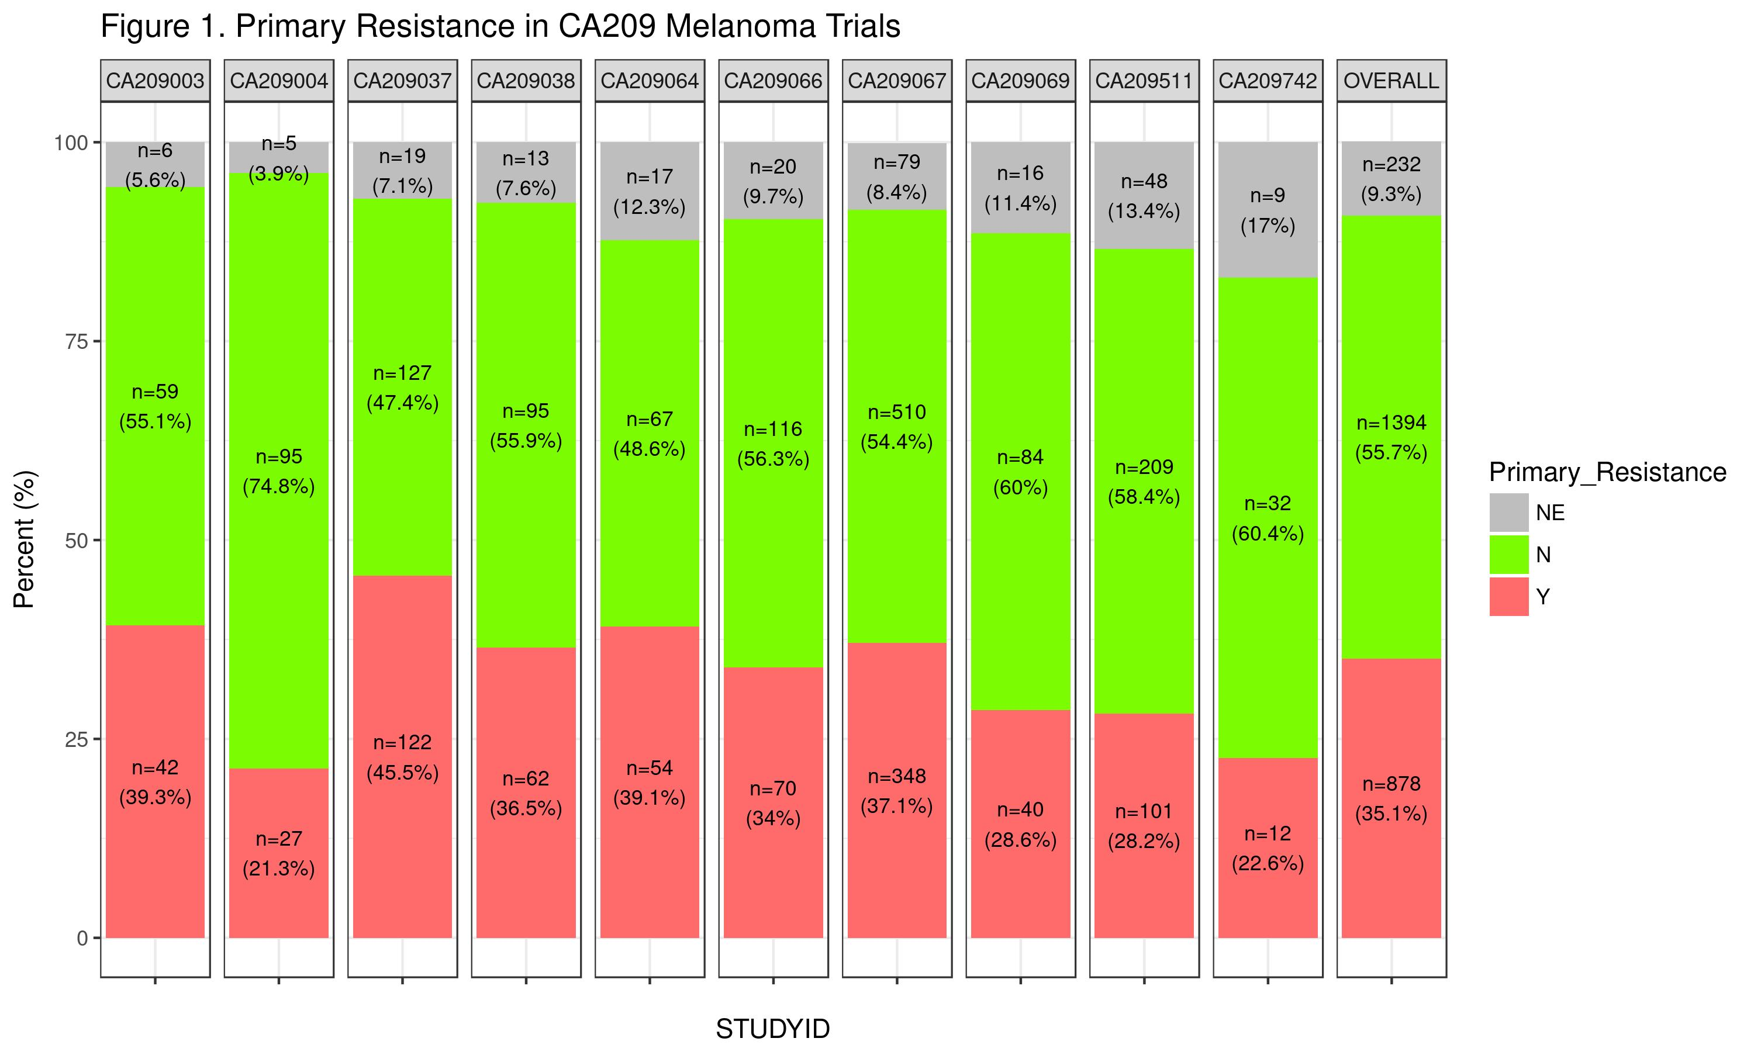
Primary resistance across metastatic melanoma studies: Similar fraction of resistant patients across various studies
35.1% (878/2504) primary resistant
Range
Low of 21.3% in CA209-004
High of 45.5% in CA209-037
9.3% (232/2504) Not evaluable

Slide 28
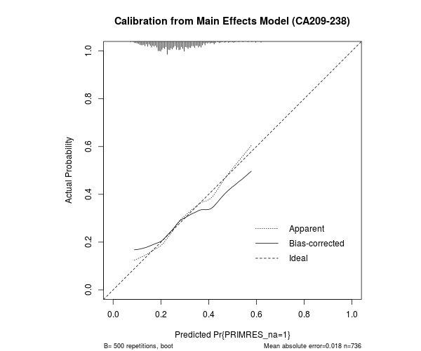
Example of Poor Calibration: Full Adjuvant data (n = 872)
 | Optimism | Corrected
Calibration Intercept | 0.30 | -0.30
Calibration Slope | 0.28 | 0.72
500 Bootstrap samples for each imputed dataset
Model seems to be poorly calibrated
Narrow range of predictions reflects poor discrimination
Sample calibration plot from randomly chosen imputed dataset

Slide 29
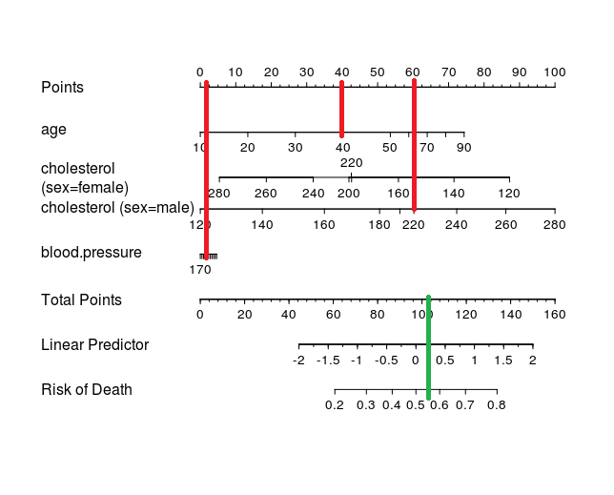
Nomogram Illustration
Obtained from stack exchange:
https://stackoverflow.com/questions/38276973/r-how-to-read-nomograms-to-predict-the-desired-variable/38317862

Slide 30
Improvements (for next time)
Use more informative priors in Bayesian modeling
If interested in making inference, first draw Directed Acyclic Graph (DAG) to avoid potential collider bias (does not affect predictions)

Slide 31
Defining primary resistance (metastatic setting)
David Paulucci,Sr. Data Scientist | GBDS
In consultation with the Melanoma Clinical Team
Not evaluable
Primary resistance
Primary resistant
Not primary resistant
No to either:
Received at least one dose
Baseline scan
Yes to all:
Received at least one dose
Baseline scan
No:
Event within 14 weeks of TRDT
Yes:
Event within 14 weeks of TRDT
No to all within 14 weeks of TRDT:
DNTD
SSTHER
DISCON
Yes to any within 14 weeks of TRDT:
DNTD
SSTHER
DISCON
Yes:
SSTHER > 1 week prior to event
No:
SSTHER > 1 week prior to event
No to all:
No event, scan > 14 w > TRDT and < SSTHER
Event > 14 w > TRDT and no SSTHER
Event > 14 w > TRST and SSTHER < 1 week prior to event
Event > 14w > TRDT and SSTHER > 1 week prior to event but scan > 14 w > TRDT and < SSTHER
Yes to any:
No event, scan > 14 w > TRDT and < SSTHER
Event > 14 w > TRDT and no SSTHER
Event > 14 w > TRST and SSTHER < 1 week prior to event
Event > 14w > TRDT and SSTHER > 1 week prior to event but scan > 14 w > TRDT and < SSTHER
Yes:
Radiographic progression is pseudoprogression
No:
Radiographic progression is pseudoprogression
Event: Radiographic or clinical progression or death due to disease.
DISCON; discontinuation from study; DNTD, death not due to disease; TRDT, treatment start date; SSTHER, subsequent therapy.

